Slide 1
Object-Oriented Programming and Data Abstraction Lesson 5: OO Design Principles
Notes:
Replace this with your course title and your name/contact details.

Slide 2
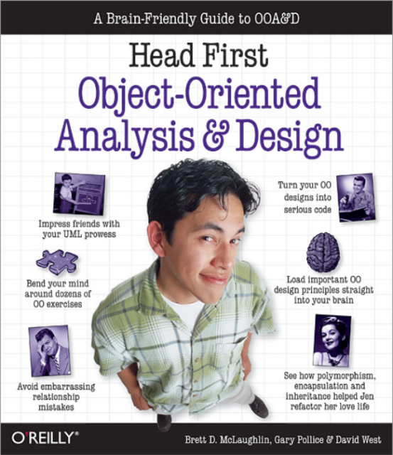
OO Design Principles

Slide 3

The Grandma/Grandpa Test
Classes are about behavior and functionality
Need to model real world objects
Classes are about behavior and functionality.
How to model NOUNS?
How to model VERBS?

Slide 4

Encapsulation
Appendix II
Encapsulation
The process of enclosing programming elements inside larger, more abstract entities. Also known as information hiding,
Safeguarding the state of an objects by defining its attributes as private and channeling access to them through accessor and mutator methods
Encapsulation is when you protect information in your code from being used incorrectly.
Example:
Setting Jet Speed
"the black box"

Slide 5
OO Design Principle #1
Object oriented design principle #1 Open / Closed principle Classes, methods or functions should be Open for extension (new functionality) and Closed for modification.
In Java, the final keyword means that a method cannot be overridden. This protects your methods from being altered by other developers and users of your objects.
Principle comes from Betrand Meyer, developer of Eiffel language and "father of object orientation."
Once completed, the implementation of a class could only be modified to correct errors. New or changed features would require a different class be created – often through inheritance.
Source: Jarvin Paul Cf: http://javarevisited.blogspot.com/2012/03/10-object-oriented-design-principles.html

Slide 6
Open Closed Principle
Appendix II
Closed for modification...
Class behavior coded just the way you want it.
Make sure that nobody can change your class’s code, and you’ve made that particular piece of behavior closed for modification.
In other words, nobody can change the behavior, because you’ve locked it up in a class that you’re sure won’t change.
...but open for extension
But then suppose someone else comes along, and they just have to change that behavior.
You really don’t want them messing with your perfect code, which works well in almost every situation...
but you also want to make it possible for them to use your code, and extend it.
Let them subclass your class, and then they can override your method to work like they want it to.
So even though they didn’t mess with your working code, you still left your class open for extension.

Slide 7
Open Closed Principle
Closed for modification...
Class behavior coded just the way you want it.
Make sure that nobody can change your class’s code, and you’ve made that particular piece of behavior closed for modification.
In other words, nobody can change the behavior, because you’ve locked it up in a class that you’re sure won’t change.
...but open for extension
Sometimes the actual class behavior of the class you wrote DOES change, this is a valid reason to modify
Sometimes you want to “extend” the functionality of the class you wrote by adding new instance variables and methods. This is a valid reason to reopen your class for modifications.

Slide 8
OO Design Principle #2
Object oriented design principle #2 DRY (Don't repeat yourself) As name suggest DRY (don't repeat yourself) means don't write duplicate code, instead use abstraction to abstract common things in one place.
If you use a hardcoded value more than one time consider making it public final constant.
If you have block of code in more than two place consider making it a separate method.
However, don't over apply this principle and apply it to unrelated things. For example don't use a single method to combine business logic for two different things whose behavior might change in the future.
Source: Jarvin Paul Cf: http://javarevisited.blogspot.com/2012/03/10-object-oriented-design-principles.html

Slide 9
OO Design Principle #3
Object oriented design principle #3 Single Responsibility Principle (SRP) Every class should have a single responsibility and that responsibility should be entirely encapsulated in the class.
This reduces the chances that an individual class will break.
It also minimizes the maintenance to a class
"A class should have one and only one reason to change." How does SRP support the Open Closed Principle?
Source: Jarvin Paul Cf: http://javarevisited.blogspot.com/2012/03/10-object-oriented-design-principles.html

Slide 10
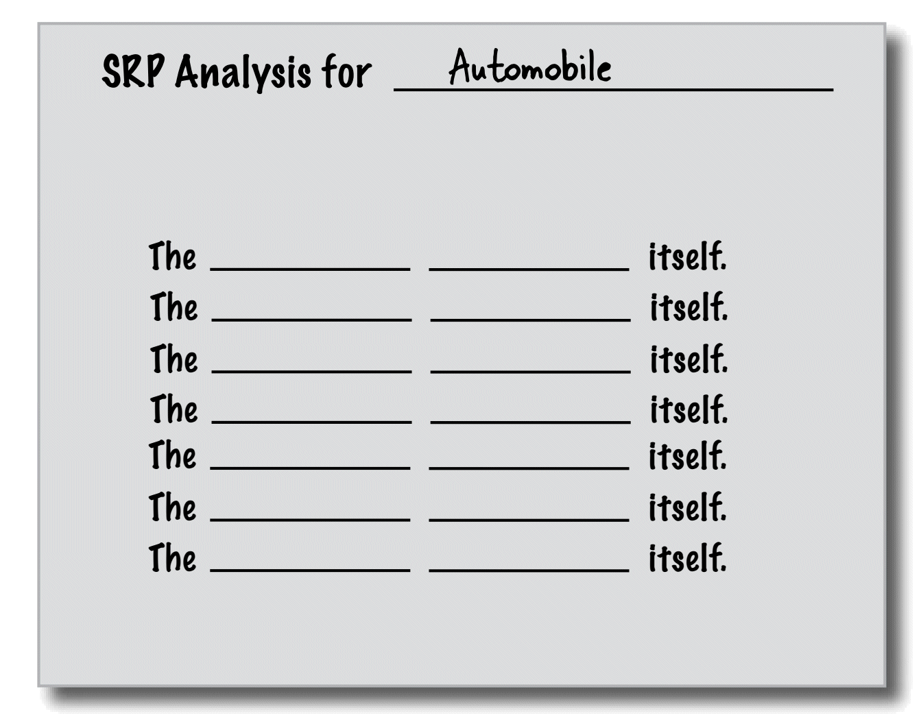
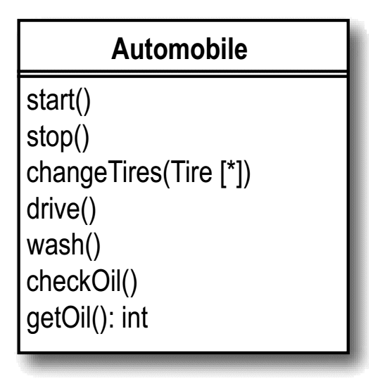
OO Design Principle #3
Object oriented design principle #3 Single Responsibility Principle (SRP)
What are the responsibilities of the Automobile>
Correct Noun
Verb (method)

Slide 11
OO Design Principle #4
Object oriented design principle #4 Liskov Substitution Principle Subtypes must be substitutable for their base types.

Slide 12
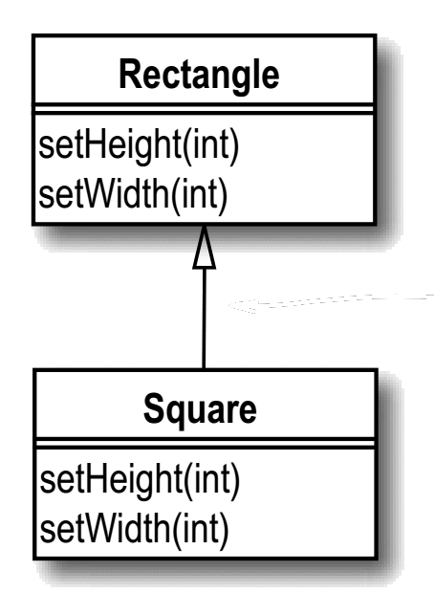
Liskov Substitution Principle Violation
If you think about a Square object, you can apply the IS-A relationship: Square IS-A Rectangle. So you should make Square extend Rectangle, right?
Rectangle square = new Square(); square.setHeight(10); square.setWidth(5);
So even though Square IS-A Rectangle, it doesn’t behave like a rectangle.

Slide 13
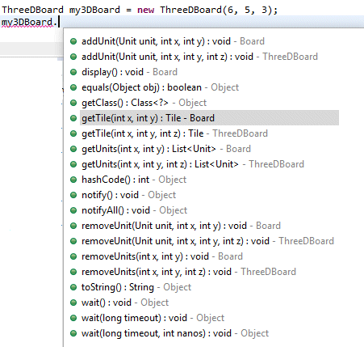
Liskov Substitution Principle Violation
ThreeDBoard inherits from Board
The Good
Fields like width and height and others are stored in one place, the superclass
The Bad
ThreeDBoard inherits 2D methods which is confusing to the user – and just plain wrong!
Check out http://jackmyers.info/oopda/src/Lesson-05/headfirst_board/

Slide 14
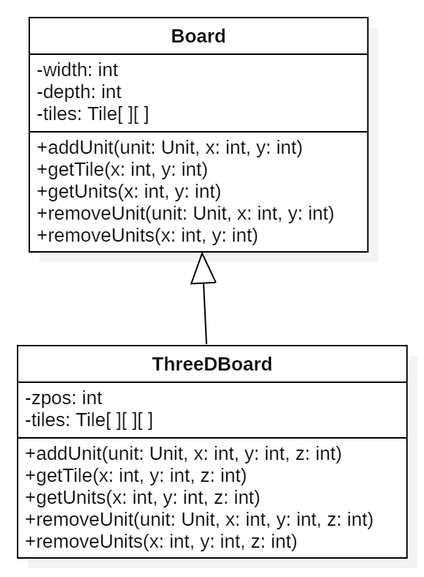
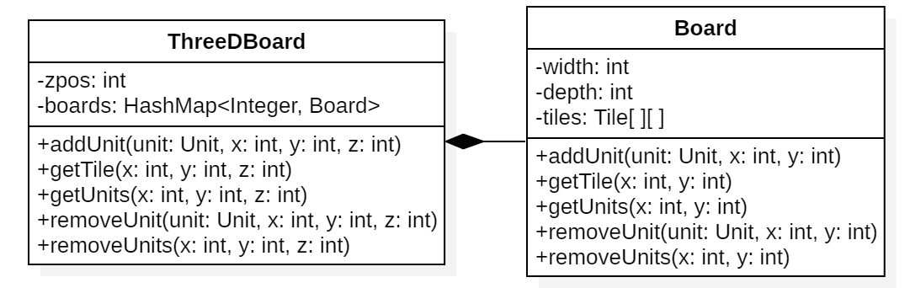
Liskov Correction thru Composition and Delegation
Originally, with inheritance, ThreeDBoard used inheritance
private Tile[][][] tiles;
public Tile getTile(int x, int y, int z) {
return tiles[x][y][z];
}
Then ThreeDBoard used composition:
private HashMap<Integer, Board> boards = new HashMap<Integer, Board>();
public Tile getTile(int x, int y, int z) {
return boards.get(z).getTile(x, y);
}
ThreeDBoard's getTile() first gets the correct board for z value, then delegates getting the Tile to Board's getTile()

Slide 15
OO Design Principle #5
Object oriented design principle #5 Encapsulate what varies Only one thing is constant in software field and that is "change." So encapsulate the code you expect or suspect to be changed in future. This way you protect the users of your code from changes in business logic
Follow principle of making variable and methods private by default
Increasing access step by step, e.g. from private to protected and not public
Consider using lambda expressions or the Strategy pattern to vary method behavior
Source: Jarvin Paul Cf: http://javarevisited.blogspot.com/2012/03/10-object-oriented-design-principles.html

Slide 16
OO Design Principle #6
Object oriented design principle #5 Favor composition or aggregation over inheritance Composition over inheritance (or composite reuse principle) in object-oriented programming is the principle that classes should achieve polymorphic behavior and code reuse by their composition (by containing instances of other classes that implement the desired functionality) rather than inheritance from a base or parent class.
Delegation Delegate behavior to another class when you don’t want to change the behavior, but it’s not your object’s responsibility to implement that behavior on its own.
Composition You can reuse behavior from one or more classes, and in particular from a family of classes, with composition. Your object completely owns the composed objects, and they do not exist outside of their usage in your object.
Aggregation When you want the benefits of composition, but you’re using behavior from an object that does exist outside

Slide 17


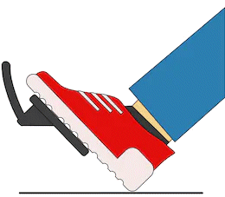
OO Design Principle #6
Object oriented design principle #5 Favor composition or aggregation over inheritance
Do you really want an inheritance hierarchy for cars with power steering, cars without power steering, cars with anti-lock brakes, cars with standard brakes…?

